Slide 1
James Joyce and Modern Fiction
Dr. Alan Haffa
Please Silence Cell Phones

Slide 2
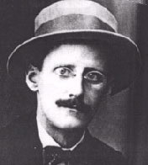
Biography, 1882-1941
Family life and the façade of Middle Class Pretense
Jesuit education
University College in Dublin
Left for Paris in 1902
Nora Barnacale; married in 32
Lived in Europe as journalist and writer

Slide 3
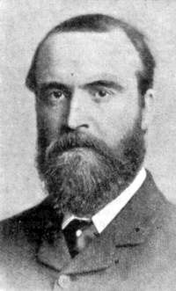
Early 20th Century Ireland
Family, Church and Irish Nationalism: he loves all three but also reacts against them
Irish nationalist Charles Stewart Parnell
Infidelity and gender tension in the family
Catholic Church was suspect in the eyes of nationalists for ‘conspiring with English’

Slide 4
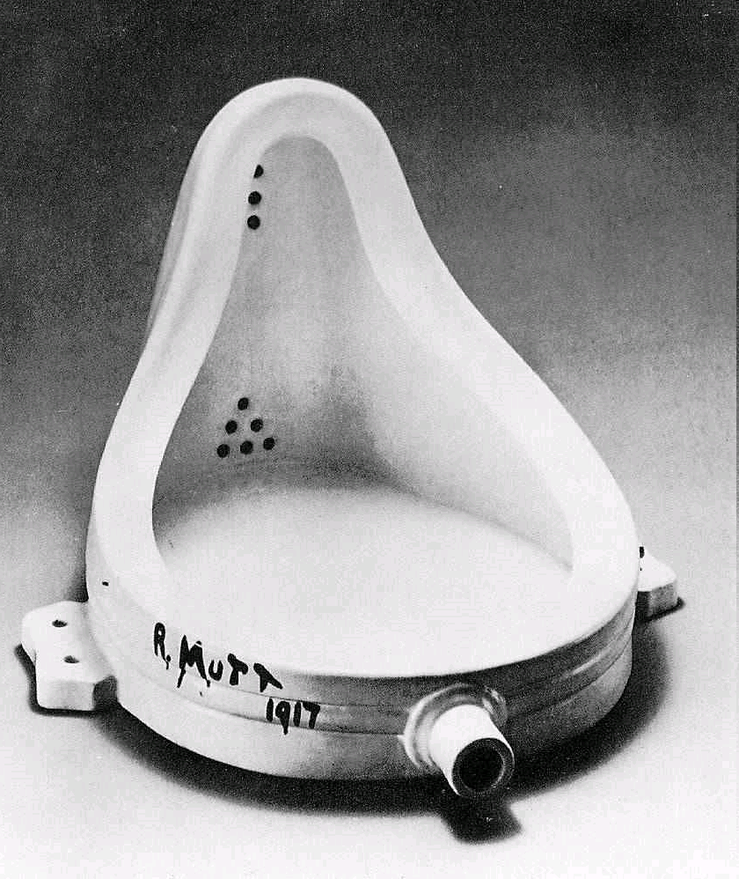
Joyce and Modern Art
Like Dadaism, the “point” is no longer to “mean” anything precisely; it is the “process” of making meaning that is of interest to Joyce
Just as artists are abandoning traditional forms, he is abandoning the structures of literature such as character, plot and setting

Slide 5
Works
Dubliners: collection of short stories set in Dublin; more narrative than the rest of his work; 1914
Portrait of the Artist as a Young Man, 1914-1915, semi-autobiographical; stream-of-consciousness narrative; psychological;
Ulysses, 1922; first published in France because of Censorship; major theme: adultery; very loosely based upon Homer’s Odyssey.
Fínnegans Wake, 1939; narrative and plot are completely obscured; verbal play; experimentation with language, embedded meaning, playful

Slide 6
Dubliners
Series of short stories
His intent was to provide a “moral history” of Ireland
Editor objected to the “stark realism—or sordidness—of several scenes”
“The Boarding House”: daughter of the home has an affair and gets pregnant; mother forces the young man, a clerk, to marry her

Slide 7
“The Dead”
Gabriel , a professor, goes to an annual New Year’s dinner hosted by his Aunts
Alienation: he is out of place in terms of class and also ethnicity; his Irishness is under challenge (Miss Ivors)
Epiphany: Song: “The Lass of Aughrim”; Wife, Greta, tells of a young man, Michael Furey, who loved her.
Who are “The Dead”? Gabriel and Greta? The Irish? Everyone?

Slide 8
Portrait of an Artist as a Young Man
Praised by Yeats, H.G. Wells, and Ezra Pound; yet, rejected by every publisher in London
Published in New York, 1916
Autobiographical
Rejection of Family, Religion, and Nation
Stephen starts out wanting to be a priest; goes through a period of sexual experimentation; has an epiphany and becomes an ascetic; sees a girl and has another epiphany
Leaves Ireland to go to Paris and pursue writing

Slide 9
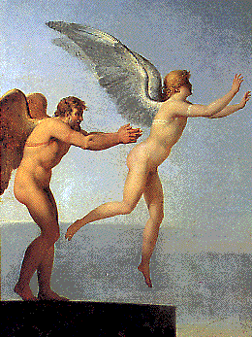
Name: Stephan Daedalus
Greek Myth: Daedalus was an inventor and scientist
Represents the aspirations of the Artist
The artistic attempt to attain spiritual transcendence and its failure
Joyce as a young artist

Slide 10
Ulysses
Banned in England, Ireland and the US; 1933 ruling by a Federal judge found the book’s language was justified artistically
Loosely structured on 18 episodes from Homer’s Odyssey.
Each in a different location in Dublin
Each parodies a specific writing style; Newspapers; Ladies Journal; Catechism
Motif: Body Organ

Slide 11
Summary of Ulysses
A day in the life of Leopold Bloom (Ulysses)
Goes to pubs, attends a funeral, goes to the newspaper to solicit an ad, goes to the post office, finds a letter from his wife’s lover, sends a letter to his erotic correspondent, lunch, sees a woman in a park expose herself, goes to a brothel, comes home and goes to bed with his wife
Stephen Daedalus, a teacher, is Telemachus, in search of a father; Bloom a sort of False Father Figure
Notes:
Young artist and old artist; the two halves of Joyce’s personna

Slide 12
What does Homer do for Joyce?
Joyce on his Homeric borrowing: “a way of controlling, of ordering, of giving a shape and significance to the immense panorama of futility and anarchy which is contemporary history”
Mock Epic novel; Joyce both parodies and yet acknowledges the greatness of Homer
The contrast of the two is the means of conveying the Modern aesthetic

Slide 13
Fínnegans Wake
Appeared in installments between 1928-1939
Early drafts were first done in the early 1920s
Subsequent drafts become more and more lyrical and allusive and less and less narrative
Time and Place do not play a structural role
Logic and language are not stable, clear systems
Layers and layers of meaning and multiplicity of languages

Slide 14
Style of Wake
Hybrid language of a dozen modern and ancient languages
Joyce: “I’d like a language, which is above all languages, a language to which all will do service. I cannot express myself in English without enclosing myself in a tradition.”
Anticipated the literary critical development of Deconstruction by thirty years; the notion that language is always insufficient; emphasis on connotative meaning rather than literal meaning

Slide 15
Summary
Psychological and surreal in Portrait of an Artist
Stark realism devoid of authorial commentary or morality in Dubliners
Ulysses is the ultimate expression of Formalism in literature; Form over Content
Finnegans Wake abandons form and narrative altogether; emphasis upon the word itself and the act of constructing meaning
Parallels the art of the period in its attempt to do something new, while still being steeped in the traditions of the past.

